Slide 1
Foreground-Background Separation In Video
By Brian Nguyen & Anthony Nguyen

Slide 2
Previous Approach
Previously, did frame by frame to understand how codebook works and see if we could isolate the background
Codebook’s algorithm is not made to do frame by frame but it helped us understand
Did not isolate the foreground yet

Slide 3
Current Approach
Playing around with the parameters to figure out what is the good balance of isolating the background to the foreground
Using codebook algorithm to go through all 307 images

Slide 4
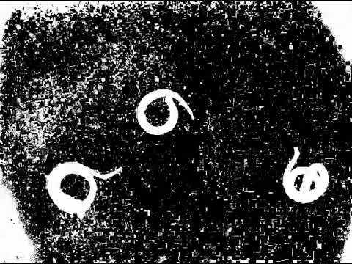
307 N/6

Slide 5

307 N/2 f 600

Slide 6
Needed Improvements
To find a good balance between the parameters for the foreground to be completely separated and to have the background to be black.
Still figuring out the parameters(which is done manually) and to find the meaning of the lambda to have the lambda automatically

